Slide 1
Lecture 5.0 Shortest Paths
Department of Computer Science
Hofstra University

Slide 2
Lecture Goals
IMPORTANT
In this lecture we study shortest-paths problems. We begin by analyzing some basic properties of shortest paths and a generic algorithm for the problem.
We introduce and analyze Dijkstra's algorithm for shortest-paths problems with nonnegative weights.
We conclude with the Bellman–Ford algorithm for edge-weighted digraphs with no negative cycles.

Slide 3
Lecture Goals
In this lecture we study shortest-paths problems. We begin by analyzing some basic properties of shortest paths and a generic algorithm for the problem.
For single-source shortest path, we consider:
Dijkstra's algorithm
Bellman–Ford algorithm
Topological Sort for DAG
For all-pairs shortest path, we conclude:
Floyd Warshall Algorithm
Johnson’s Algorithm

Slide 4
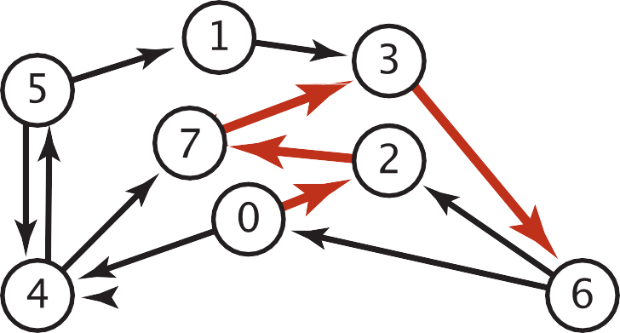
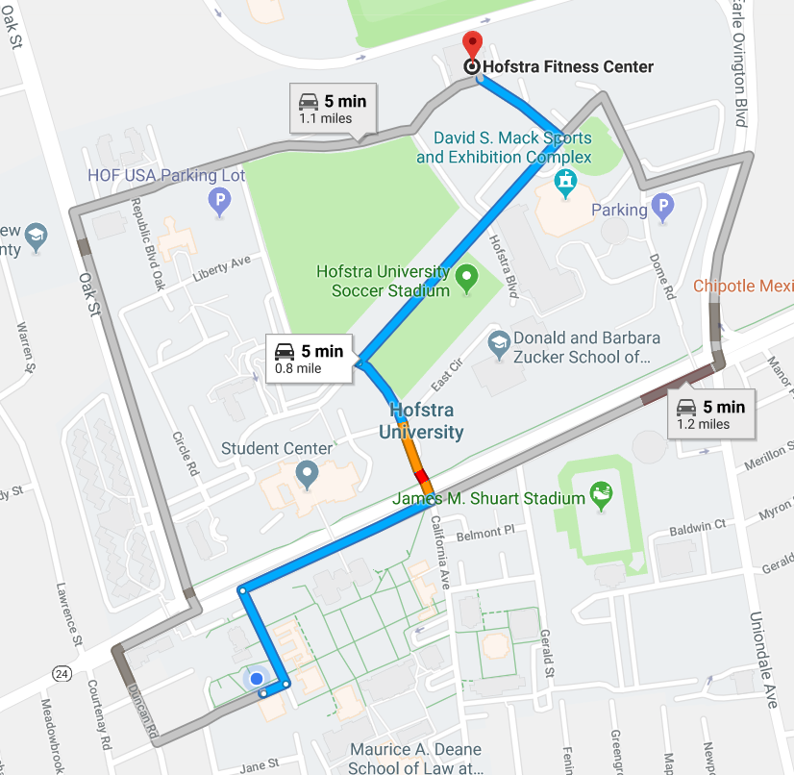

Shortest Paths in an Edge-weighted Digraph
Given an edge-weighted digraph, find the shortest path from source vertex s to t.
edge-weighted digraph
shortest path from 0 to 6
0->2 0.26
4->5 | 0.35
5->4 | 0.35
4->7 | 0.37
5->7 | 0.28
7->5 | 0.28
5->1 | 0.32
0->4 | 0.38
0->2 | 0.26
7->3 | 0.39
1->3 | 0.29
2->7 | 0.34
6->2 | 0.40
3->6 | 0.52
6->0 | 0.58
6->4 | 0.93
2->7 | 0.34
7->3 | 0.39
3->6 | 0.52
Variants
Which vertices?
Single source: from source vertex s to every other vertex.
Source-sink: from source vertex s to another t.
All pairs: between all pairs of vertices.
Nonnegative weights?
Cycles?
Negative cycles.
Simplifying assumption: Each vertex is reachable from s.

Slide 5

Edge Relaxation
Relax edge e = u→v with weight w(u,v). (We also write uv to denote u→v)
distTo[u] is length of shortest known path from s to u.
distTo[v] is length of shortest known path from s to v.
prevNode[v] is the previous vertex on shortest known path from s to v.
If e = u→v gives shorter path to v through u, update distTo[v] and prevNode[v].
distTo[v] = min(distTo[v], distTo[u] + w(u,v)); prevNode[v]=u
After relaxing edge uv, the shortest path from s to v is updated to go through vertex u, with cost of 4.4
prevNode[v]=u
private void relax(DirectedEdge e)
{
Int u = e.from(), v = e.to();
if (distTo[v] > distTo[u] + w(u,v))
{
distTo[v] = distTo[u] + w(u,v);
prevNode[v] = u;
}
}
3.1
u
1.3
s
v
7.2
OLD distTo[v] = 7.2 > distTo[u] + w(u,v)
= 3.1+1.3 = 4.4
NEW distTo[v] ← distTo[u] + w(u,v) = 4.4, prevNode[v] = u
x
Previous shortest path from s to v goes through vertex x, with cost of 7.2
Notes:
Dijkstra’s Algorithm is greedy and optimal: any vertex that has been visited should have its shortest distance to the source.

Slide 6
Generic Shortest-paths Algorithm
Generic algorithm (to compute SPT from s)
For each vertex v: distTo[v] = ∞.
For each vertex v: prevNode[v] = null.
distTo[s] = 0.
Repeat until done:
- Relax any edge.
Proposition. Generic algorithm computes SPT (if it exists) from s.
Pf.
Throughout algorithm, distTo[v] is the length of a simple path from s to v (and prevNode[v] is its previous vertex on the path).
Each successful relaxation decreases distTo[v] for some v.
The entry distTo[v] can decrease at most a finite number of times.
Efficient implementations. How to choose which edge to relax?
Ex 1. Dijkstra’s algorithm. (no negative weights).
Ex 2. Bellman–Ford algorithm. (negative weights, can detect negative cycles).
Ex 3. Topological sort. (DAG with no directed cycles)
Notes:
Ex 2. Topological sort algorithm. (no directed cycles).

Slide 7
Dijkstra's Algorithm
Initialization:
Set the distance to the source vertex as 0 and to all other vertices as infinity.
Mark all vertices as unvisited and store them in a priority queue.
Main Loop:
Visit the unvisited vertex u with the shortest known distance from the queue.
For each unvisited neighbor vertex v of vertex u, calculate its tentative distance through the current vertex. If this distance is smaller than the previously recorded distance, update it with edge relaxation for edge uv.
Mark the current vertex as visited once all its neighbors are processed.
Termination:
The algorithm continues until all reachable vertices are visited.
Time complexity: O(V log V + V) for Binary Heap implementation
Notes:
Dijkstra’s Algorithm is greedy and optimal: any vertex that has been visited should have its shortest distance to the source.
It works for both undirected and directed graphs. The only difference is the function for getting the neighbors of vertex v, as each undirected edge is treated as two directed edges in opposite directions.)
Notes:
which follows the edge arrow direction for directed graphs

Slide 8
Dijkstra’s Algorithm: Correctness Proof
Proposition. Dijkstra's algorithm computes a SPT in any edge-weighted digraph with nonnegative weights.
Proof.
Each edge e = u→v is relaxed exactly once (when vertex u is visited), afterwards:
distTo[v] ≤ distTo[u] + w(u,v).
Inequality holds until algorithm terminates because:
distTo[v] cannot increase
distTo[u] will not change
Thus, upon termination, shortest-paths optimality conditions hold.
distTo[ ] values are monotone decreasing
we choose lowest distTo[ ] value at each step (and edge weights are nonnegative)

Slide 9
Toy Example: find shortest path starting from source vertex S for undirected graph SD: Shortest Distance. PN: Previous Node
A
2
S
1
4
B
N1 | SD | PN
S | 0
A | $$∞$$
B | $$∞$$
N1 | SD | PN
S | 0
A | 2 | S
B | 4 | S
N1 | SD | PN
S | 0
A | 2 | S
B | 3 | A
N1 | SD | PN
S | 0
A | 2 | S
B | 3 | A
Visit S
Visit A
Visit B
A
2
S
3
4
B
N1 | SD | PN
S | 0
A | $$∞$$
B | $$∞$$
N1 | SD | PN
S | 0
A | 2 | S
B | 4 | S
N1 | SD | PN
S | 0
A | 2 | S
B | 4 | S
N1 | SD | PN
S | 0
A | 2 | S
B | 4 | S
Visit S
Visit A
Visit B

Slide 10
Toy Example: find shortest path starting from source vertex S for directed graph
A
2
S
1
4
B
N1 | SD | PN
S | 0
A | $$∞$$
B | $$∞$$
N1 | SD | PN
S | 0
A | 2 | S
B | 4 | S
N1 | SD | PN
S | 0
A | 2 | S
B | 4 | S
N1 | SD | PN
S | 0
A | 2 | S
B | 4 | S
Visit S
Visit A
Visit B
A
2
S
1
4
B
N1 | SD | PN
S | 0
A | $$∞$$
B | $$∞$$
N1 | SD | PN
S | 0
A | $$∞$$
B | 4 | S
N1 | SD | PN
S | 0
A | 5 | B
B | 4 | S
N1 | SD | PN
S | 0
A | 5 | B
B | 4 | S
Visit S
Visit B
Visit A

Slide 11
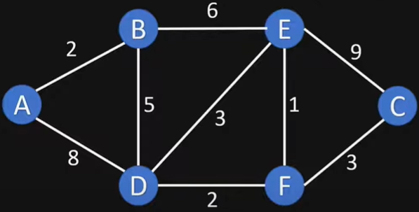
Example Graph

Slide 12
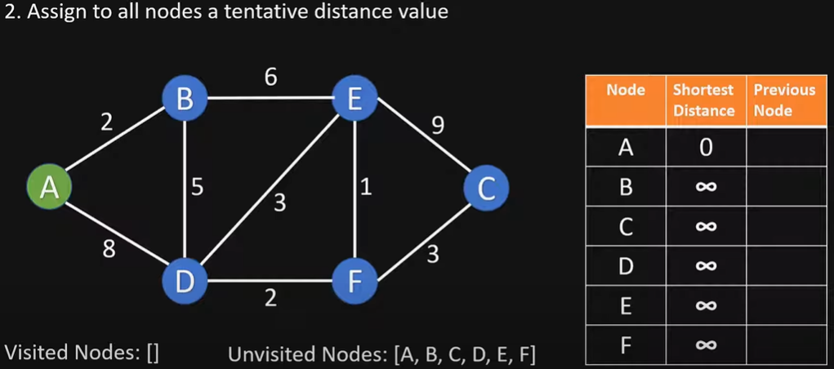
Initialize

Slide 13
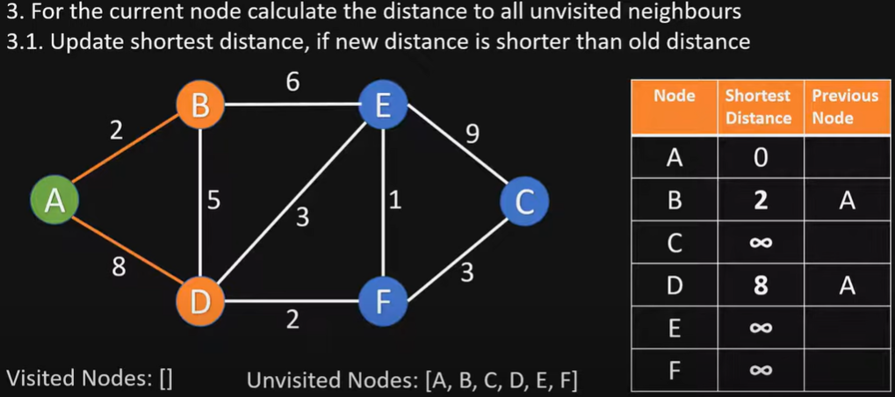
Visit vertex A
OLD distTo[B] = $∞$ > distTo[A] + w(A,B) = 0+2 = 2
NEW distTo[B] ← distTo[A] + w(A,B) = 2, prevNode[B] = A
OLD distTo[D] = $∞$ > distTo[A] + w(A,D) = 0+8 = 8
NEW distTo[D] ← distTo[A] + w(A,D) = 8, prevNode[D] = A

Slide 14
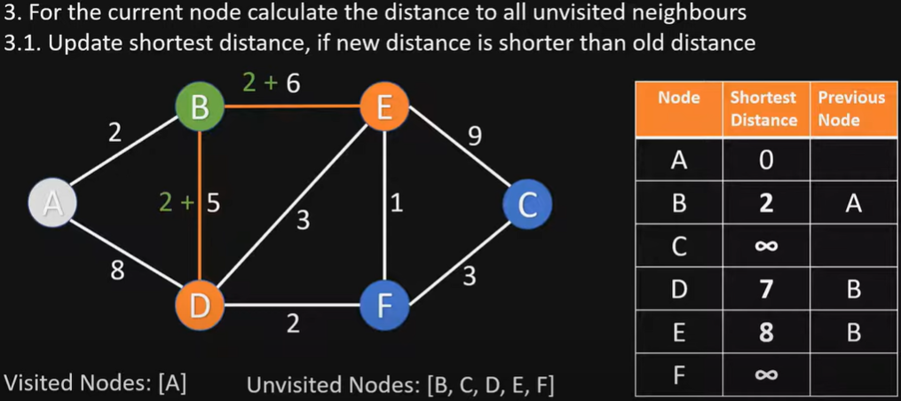
Visit vertex B
OLD distTo[D] = 8 > distTo[B] + w(B,D) = 2+5 = 7
NEW distTo[D] ← distTo[B] + w(B,D) = 7, prevNode[D] = B
OLD distTo[E] = $∞$ > distTo[B] + w(B,E) = 2+6 = 8
NEW distTo[E] ← distTo[B] + w(B,E) = 8, prevNode[E] = B

Slide 15
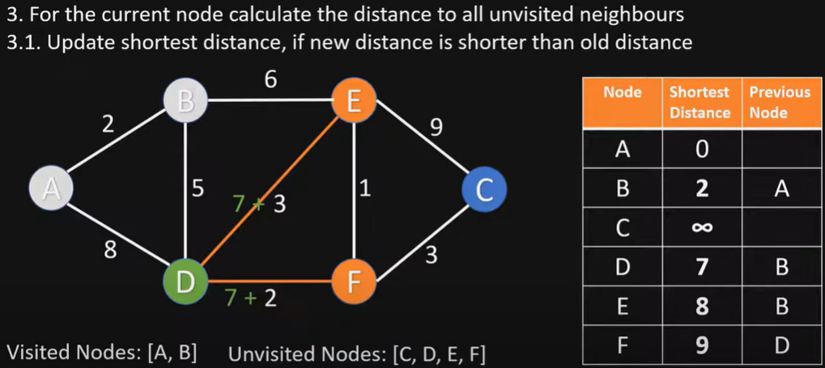
Visit vertex D
OLD distTo[E] = 8 < distTo[D] + w(D,E) = 7+3 = 10
No update, distTo[E] stays 8, prevNode[E] stays B
OLD distTo[F] = $∞$ > distTo[D] + w(D,F) = 7+2 = 9
NEW distTo[F] ← distTo[D] + w(D,F) = 9, prevNode[F] = D

Slide 16
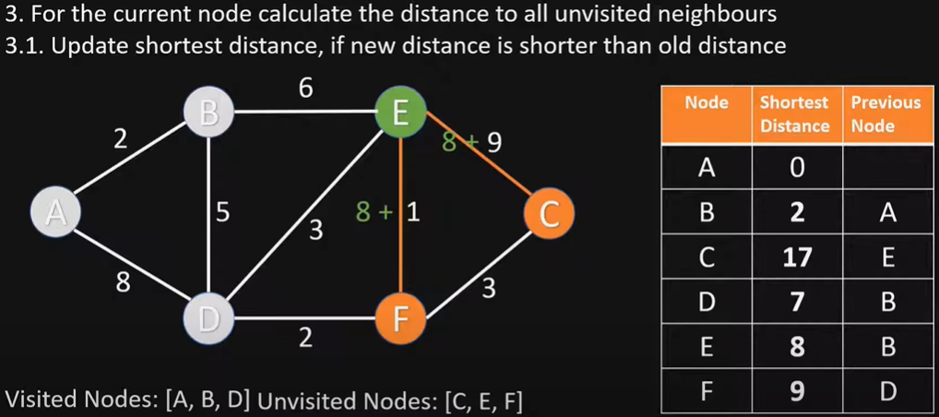
Visit vertex E
OLD distTo[C] = $∞$ > distTo[E] + w(E.C) = 8+9 = 17
NEW distTo[C] ← distTo[E] + w(E.C) = 17, prevNode[C] = E
OLD distTo[F] = 9 = distTo[E] + w(E.F) = 8+1 = 9
No update, distTo[F] stays 9, prevNode[F] = D (You can also update prevNode[F] = E.)

Slide 17
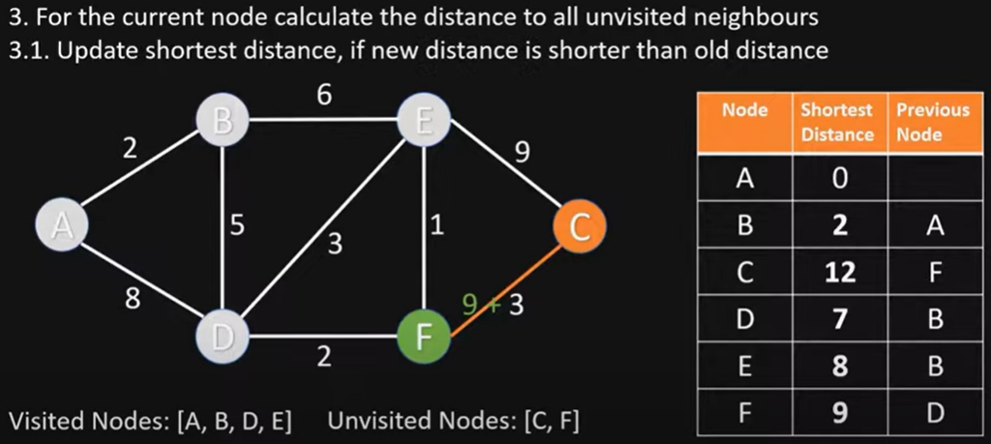
Visit vertex F
OLD distTo[C] = 17 > distTo[F] + w(F,C) = 9+3 = 12
NEW distTo[C] ← distTo[F] + w(F,C) = 12, prevNode[C] = F

Slide 18
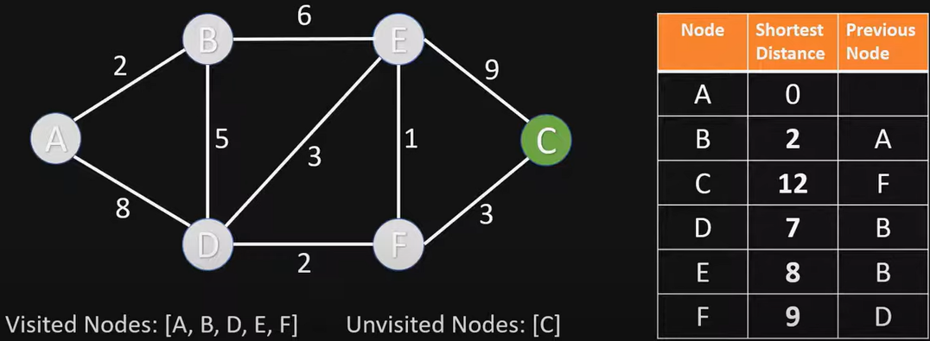
Visit vertex C
Nothing changes, since C has no unvisited neighbor vertices

Slide 19
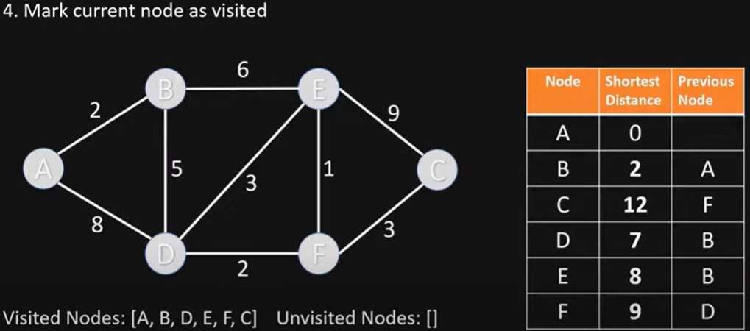
End of Algorithm
Table contains the shortest distance to each vertex N from the source vertex A, and its previous vertex in the shortest path

Slide 20
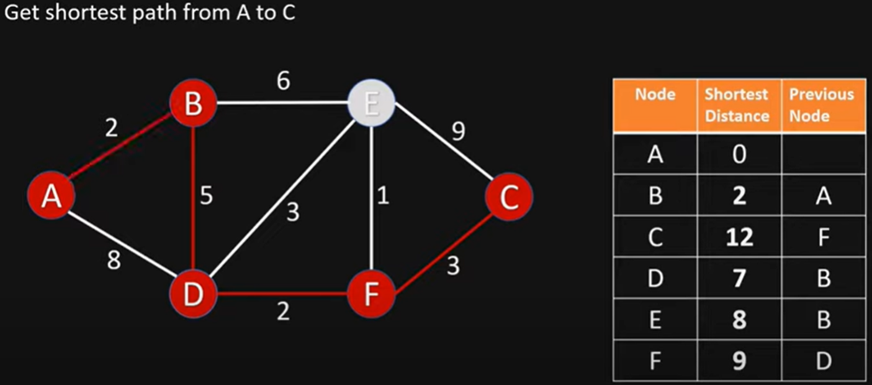
Getting the Shortest Path from A to C
C’s previous vertex is F; F’s previous vertex is D; D’s previous vertex is B; B’s previous vertex is A
Shortest Path from A to C is ABDFC

Slide 21
Dijkstra’s Algorithm Example 2
3
B
D
3
1
A
1
2
1
C
E
4
Notes:
David Kauchak
cs161
Summer 2009
Graphs: MSTs and Shortest Paths https://cs.pomona.edu/~dkauchak/classes/algorithms/

Slide 22
Initialize
∞
∞
3
N | SD | PN
A | 0
B | $$∞$$
C | $$∞$$
D | $$∞$$
E | $$∞$$
B
D
3
0
1
A
1
2
∞
1
C
E
∞
4

Slide 23
Visit vertex A
3
∞
3
N | SD | PN
A | 0
B | 3 | A
C | 1 | A
D | $$∞$$
E | $$∞$$
B
D
3
0
1
A
1
2
1
1
C
E
∞
4

Slide 24
Visit vertex C
2
∞
3
N | SD | PN
A | 0
B | 2 | C
C | 1 | A
D | $$∞$$
E | 5 | C
B
D
3
0
1
A
1
2
1
1
C
E
5
4

Slide 25
Visit vertex B
2
5
3
N | SD | PN
A | 0
B | 2 | C
C | 1 | A
D | 5 | B
E | 3 | B
B
D
3
0
1
A
1
2
1
1
C
E
3
4

Slide 26
Visit vertex E
2
5
3
B
D
N | SD | PN
A | 0
B | 2 | C
C | 1 | A
D | 5 | B
E | 3 | B
3
0
1
A
1
2
1
1
C
E
3
4
Nothing changes

Slide 27
Visit vertex D
2
5
3
N | SD | PN
A | 0
B | 2 | C
C | 1 | A
D | 5 | B
E | 3 | B
B
D
3
0
1
A
1
2
1
1
C
E
3
4
Nothing changes

Slide 28
Dijkstra’s Algorithm Example 3
choose vertex 5
relax all edges adjacent from 5
choose vertex 2
relax all edges adjacent from 2
choose vertex 3
relax all edges adjacent from 3
choose vertex 6
relax all edges adjacent from 6
Consider vertices in increasing order of distance from s
(non-tree vertex with the lowest distTo[ ] value).
Add vertex to tree and relax all edges pointing from that vertex.
1
v distTo[]
15
3
$$∞$$
$∞$ $∞$
$$∞$$
$$∞$$
$$∞$$
$$∞$$
$$∞$$
0
5
17
20
9
14
29
8
15
17
13
26
14
25
0
1
2
3
4
5
6
7
5
4
12
0
3
8
7
2
7
9
9
5
6
1
5
11
v edgeTo[]
4
4
13
6
0
1
2
3
4
5
6
7
-
-
-
-
-
-
-
-
0
1
1
0
7
4
0
7
2
4
5
5
2
20
choose source vertex 0
relax all edges adjacent from 0
choose vertex 1
relax all edges adjacent from 1
choose vertex 7
relax all edges adjacent from 7
choose vertex 4
relax all edges adjacent from 4

Slide 29
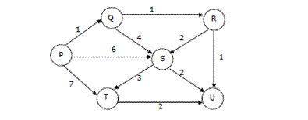
Dijkstra’s Algorithm Example 4
Suppose we run Dijkstra’s single source shortest-path algorithm on the following edge weighted directed graph with vertex P as the source. In what order do the vertices get included into the set of vertices for which the shortest path distances are finalized?
ANS: P, Q, R, U, S, T

Slide 30
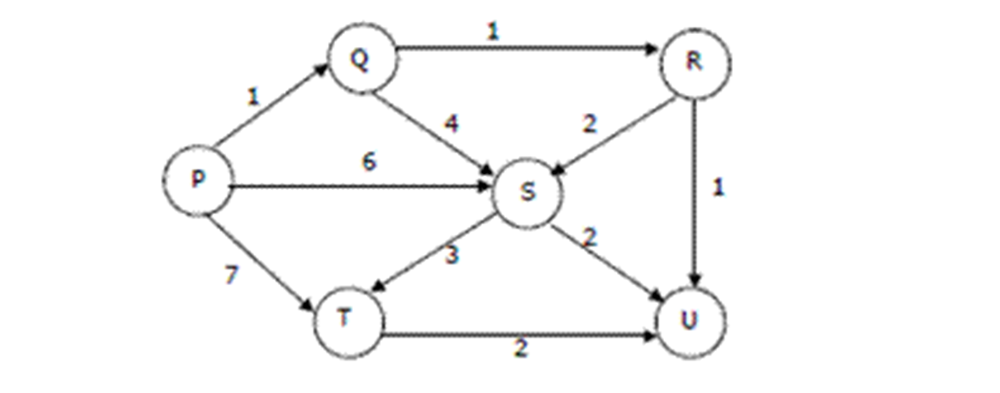
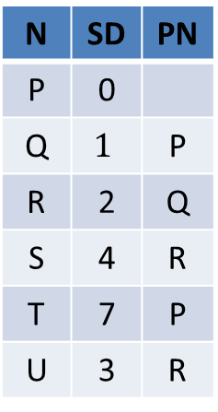
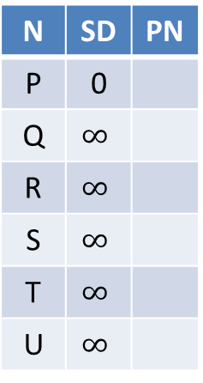
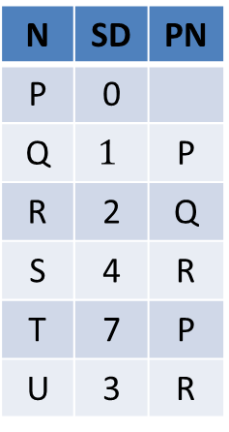
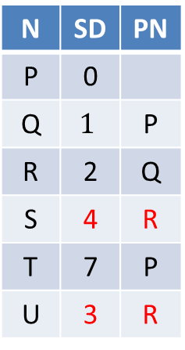
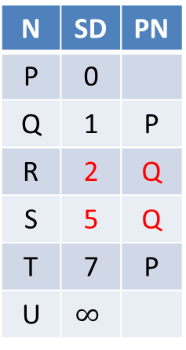
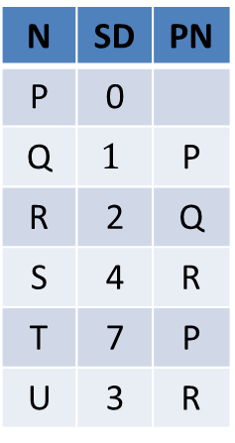
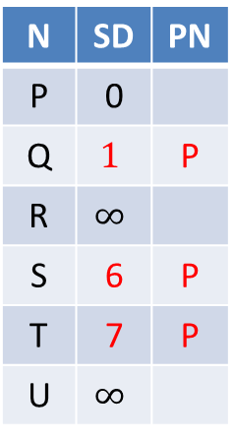

SD: Shortest Distance
PN: Previous vertex
N | SD | PN
P | 0
Q | $$∞$$
R | $$∞$$
S | $$∞$$
T | $$∞$$
U | $$∞$$
N | SD | PN
P | 0
Q | $$1$$ | P
R | $$∞$$
S | 6 | P
T | 7 | P
U | $$∞$$
N | SD | PN
P | 0
Q | 1 | P
R | 2 | Q
S | 5 | Q
T | 7 | P
U | $$∞$$
N | SD | PN
P | 0
Q | $$1$$ | P
R | 2 | Q
S | 4 | R
T | 7 | P
U | 3 | R
Visit P
Visit Q
Visit R
Visit U (nothing changes)
N | SD | PN
P | 0
Q | $$1$$ | P
R | 2 | Q
S | 4 | R
T | 7 | P
U | 3 | R
N | SD | PN
P | 0
Q | $$1$$ | P
R | 2 | Q
S | 4 | R
T | 7 | P
U | 3 | R
N | SD | PN
P | 0
Q | $$1$$ | P
R | 2 | Q
S | 4 | R
T | 7 | P
U | 3 | R
N | SD | PN
P | 0
Q | $$1$$ | P
R | 2 | Q
S | 4 | R
T | 7 | P
U | 3 | R
Visit S
Visit T
Finished
(nothing
changes)
(nothing
changes)

Slide 31
Bellman-Ford Algorithm
Initialize distance array distTo[] for each vertex v as distTo[v] = $∞$, and distTo[s] = 0 to source vertex s.
Relax all edges V-1 times.
Can terminate early when all distTo[] values have converged
The order of edge relaxations affects algorithm efficiency but not correctness.
Recall:
Generic algorithm (to compute SPT from s)
For each vertex v: distTo[v] = ∞.
For each vertex v: edgeTo[v] = null.
distTo[s] = 0.
Repeat until done:
- Relax any edge.
private void relax(DirectedEdge e)
{
Int u = e.from(), v = e.to();
if (distTo[v] > distTo[u] + w(u,v))
{
distTo[v] = distTo[u] + w(u,v);
prevNode[v] = u;
}
}
Bellman–Ford algorithm
For each vertex v: distTo[v] = ∞.
For each vertex v: edgeTo[v] = null.
distTo[s] = 0.
Repeat V-1 times:
- Relax each edge.
Notes:
Now, Relax all the edges one more time i.e. the Nth time and based on the below two cases we can detect the negative cycle:
Case 1 (Negative cycle exists): For any edge(u, v, weight), if dist[u] + weight < dist[v]
Case 2 (No Negative cycle) : case 1 fails for all the edges.
Initialize distance array dist[] for each vertex ‘v‘ as dist[v] = INFINITY.
Assume any vertex (let’s say ‘0’) as source and assign dist = 0.
Relax all the edges(u,v,weight) N-1 times as per the below condition:
dist[v] = minimum(dist[v], dist[u] + weight)
Now, Relax all the edges one more time i.e. the Nth time and based on the below two cases we can detect the negative cycle:
Case 1 (Negative cycle exists): For any edge(u, v, weight), if dist[u] + weight < dist[v]
Case 2 (No Negative cycle) : case 1 fails for all the edges.

Slide 32
Bellman-Ford Algorithm Proof of Correctness
Relaxing edges V-1 times in the Bellman-Ford algorithm guarantees that the algorithm has explored all possible paths with up to V-1 edges, which is the maximum possible number of edges of a shortest path in a graph with V vertices.
This allows the algorithm to correctly calculate the shortest paths from the source vertex to all other vertices, given that there are no negative-weight cycles.

Slide 33
Bellman-Ford Algorithm with Negative Cycle Detection
Initialize distance array distTo[] for each vertex v as distTo[v] = $∞$, and distTo[s] = 0 to source vertex s.
Relax all edges V-1 times.
Can terminate early when all distTo[] values have converged
The order of edge relaxations affects algorithm efficiency but not correctness. A good heuristic is to follow the Breadth First Search (BFS) order.
Relax all the edges one more time i.e. the V-th time:
Case 1 (Negative cycle exists): if any edge can be further relaxed, i.e., for any edge u→v, if distTo[u] > distTo[u] + w(u,v)
Case 2 (No Negative cycle) : case 1 fails for all the edges.
Notes:
It can find any negative cycle that is reachable from source vertex s (but not negative cycles that are unreachable from s).
If there is a negative cycle that is reachable from source vertex s, then any paths that go through the cycle has distance $−∞$, since the cost can be reduced by traversing the cycle infinite number of times.
Notes:
Initialize distance array dist[] for each vertex ‘v‘ as dist[v] = INFINITY.
Assume any vertex (let’s say ‘0’) as source and assign dist = 0.
Relax all the edges(u,v,weight) N-1 times as per the below condition:
dist[v] = minimum(dist[v], dist[u] + weight)
Now, Relax all the edges one more time i.e. the Nth time and based on the below two cases we can detect the negative cycle:
Case 1 (Negative cycle exists): For any edge(u, v, weight), if dist[u] + weight < dist[v]
Case 2 (No Negative cycle) : case 1 fails for all the edges.

Slide 34
Time Complexity of Bellman-Ford Algorithm
Time complexity for connected graph:
Average Case: O(VE)
Worst Case: O(VE)
If the graph is dense or complete, the value of E becomes O(V²). So overall time complexity becomes O(V³)
Notes:
Best Case: O(E), when distance array after 1st and 2nd relaxation are same , we can simply stop further processing after one iteration
What is the time complexity of Bellman-Ford single-source shortest path algorithm on a complete graph of n vertices?
ANS: O(V3)
Time complexity of Bellman-Ford Algorithm Example 1 is O(VE) where V is number of vertices and E is number edges . If the graph is complete, the value of E becomes O(V2). So overall time complexity becomes O(V3)

Slide 35
Bellman-Ford Algorithm Example 1
Repeat V − 1 times: relax all E edges.
v distTo[]
0
1
2
3
4
5
6
7
$$∞$$
$∞$ $∞$
$$∞$$
$$∞$$
$$∞$$
$$∞$$
$$∞$$
0
5
17
20
9
13
28
8
14
17
26
25
1
15
3
5
4
12
0
3
8
7
2
7
9
Reverse order of edge relaxations will result in slower convergence
v edgeTo[]
9
5
6
1
0
1
2
3
4
5
6
7
-
-
-
-
-
-
-
-
0
1
1
0
4
2
0
5
2
5
2
5
11
4
4
13
20
6
pass 1
pass 2
pass 3
(converged, no further changes, so stop here)
0→1 0→4 0→7 1→2 1→3 1→7 2→3 2→6 3→6 4→5 4→6 4→7 5→2 5→6 7→2 7→5
Order of edge relaxations

Slide 36
Dijkstra's Algorithm vs. Bellman-Ford Algorithm
Dijkstra's Algorithm:
Uses a priority queue to select the next vertex to process.
Greedily selects the vertex with the smallest tentative distance to source vertex.
Works only on graphs with non-negative edge weights.
Bellman-Ford Algorithm:
Iteratively relaxes all edges V-1 times.
Does not use a priority queue.
Can handle graphs with negative edge weights, and can detect negative cycles.
Dijkstra's algorithm is faster and more efficient for graphs with non-negative weights; Bellman-Ford Algorithm is more versatile as it can handle negative weights and detect negative cycles, albeit at the cost of lower efficiency.
Notes:
Dijkstra's Algorithm:
- Finds the shortest path from a single source vertex to all other vertices in a graph with non-negative edge weights.
**Bellman-Ford Algorithm:**
- Finds the shortest path from a single source vertex to all other vertices in a graph, even with negative edge weights.
- Can detect negative cycles in the graph.
Time complexity of O(V^2) for a dense graph and O(E log V) for a sparse graph.
Time complexity of O(VE), where V is the number of vertices and E is the number of edges in the graph.
, where V is the number of vertices
## Edge Weight Handling
**Dijkstra's Algorithm:**
- Works only on graphs with non-negative edge weights.
**Bellman-Ford Algorithm:**
- Can handle graphs with negative edge weights.
- Can detect negative cycles.
## Performance
Dijkstra's Algorithm:
- More efficient for graphs with non-negative weights.
- Time complexity: O(V log V + E) with a binary heap implementation, where V is the number of vertices and E is the number of edges.
**Bellman-Ford Algorithm:**
- Generally slower than Dijkstra's.
- Time complexity: O(VE), where V is the number of vertices and E is the number of edges.
## Implementation

Slide 37
Quiz
Given a graph where all edges have positive weights, the shortest paths produced by Dijsktra and Bellman Ford algorithm may be different but path weight would always be same.
ANS: True
Dijkstra and Bellman-Ford both work fine for a graph with all positive weights, but they are different algorithms and may pick different edges for shortest paths.

Slide 38
Quiz
Let G be a directed graph whose vertex set is the set of numbers from 1 to 100. There is an edge from a vertex i to a vertex j if either j = i + 1 or j = 3i. The minimum number of edges in a path in G from vertex 1 to vertex 100 is
A. 4 B. 7 C. 23 D. 99
ANS: 7
The task is to find minimum number of edges in a path in G from vertex 1 to vertex 100 such that we can move to either i+1 or 3i from a vertex i.
Since the task is to minimize number of edges, we would prefer to follow 3*i. Let us follow multiple of 3. 1 => 3 => 9 => 27 => 81, now we can't follow multiple of 3 anymore. So we will have to follow i+1. This solution gives a long path.
What if we begin from end, and we reduce by 1 if the value is not multiple of 3, else we divide by 3. 100 => 99 => 33 => 11 => 10 => 9 => 3 => 1
So we need total 7 edges.

